Slide 1
SHOMREI HA’ARETZ -STEWARDS of the LAND PROTECT vs. USE Jewish Foot Prints on the Land
FJMC & GreenFaith Energy and Water Shield Programs
By: Jeffry Charnow, Men’s Club President
Temple Torat Emet, Boynton Beach, Florida
Michael W. Miller, FJMC Shomrei Ha’Aretz Chair
Temple Beth O’r-Beth Torah, Clark, New Jersey
Notes:
Created by:
Jeffry Charnow
JeffCharnow@gmail.com
Temple Torat Emet
(Formally Temple Torah of West Boynton Beach)
Boynton Beach Florida 33472
(561) 733-8695
Michael W Miller
Drmike@millerchemist.com
Temple Beth O’r-Beth Torah, Clark, New Jersey 07066
908-233-9624
The Earth (land, air, water) is not merely some resource to be used and abused. If we want to live on the land, it is our responsibility to not destroy the biological productivity of the earth with trash dumps, slag heaps, chemical waste ponds, smoke stacks spewing toxins and sewage. Consider what Condition will this earth be in when our children and grandchildren take over as adults?
These programs encourage involvement.

Slide 2
FJMC & GreenFaith Energy and Water Shield Programs - Session Format
Common Properties of Energy Shield & Water Shields
Specifics of Energy Shield & Water Shield
Questions & Comments
From floor: What Environmental activities do Shuls/Clubs present
Notes:
National Environmental Merit Badge for faith based communities
Allows congregations to easily adopt sustainability practices
Can be earned within a month, with effective MEASURABLE results
Is a Ready To Go project, with guidelines, handouts, support – everything you need
IT ALLOWS YOU TO MAKE A DIFFEREnce

Slide 3
The Shield Program
National environmental merit badge for faith communities
Guides congregations to adopt easy sustainability practices
Manageable timeframe (can be earned in a month)
Effective measurable results
Ready-to-go project, Everything you need is included
Notes:
National Environmental Merit Badge fro faith based communities
Allows congregations to easily adopt sustainability practices
Can be earned within a month, with effective MEASURABLE results
Is a Ready To Go project, with guidelines, handouts, support – everything you need
IT ALLOWS YOU TO MAKE A DIFFERENCE

Slide 4




The Shield is not

Slide 5


The GreenFaith Shields

Slide 6

Why Do it ?
Synagogues behind the times
Already do it at home
Losing Money
This is not something new…
…just new to the Synagogue
Be part of the movement – FJMC, USCJ, WLCJ, RA
Notes:
Most synagogues today are woefully behind the times in being energy efficient and Conserving Water
The buildings are older and much of the infrastructure has never been remodeled or updated
Be part of the movement – FJMC, USCJ, WLCJ, RA
Synagogues of all denominations are working with GreenFaith
Religious institutions of all faiths are participating
Oh, and you do get a parchment and an electronic shield to put on your website.

Slide 7
Energy: Did You Know?
Replacing an incandescent exit sign with LEDs usually has a payback of 1 year on average
Swap out 2 15 watt bulbs with 2 watt LEDs
Dust or drafts around windows indicate air leaks
Hot water heaters keep water hot 24 hours a day, whether used or not
Fluorescent bulb retrofitting and/or replacement may be the most important opportunity for lighting efficiency.
Retrofitting T-12s with the ½ ’’ smaller T-8s
T-12’s are no longer be made as of 2014, prices on them continue to increase.
Notes:
Did you know that you can save money with the exit signs?
Do you know how to spot air leaks by looking at dust lines or using a candle?
Did you know that you hot water heater is working 24 hours a day, and does not need to
The fluorescent bulbs you use may no longer be manufactured
Why do the Energy Shield Program?? Do it because Institutions frequently reduce their energy use and carbon footprint by 20% or more.
Households can do the same.

Slide 8
Water: Did You Know?
Install faucet restrictors reduce flow by 20%, maintain pressure
Replace old Toilets with models that achieve 1.3 gallons per flush, save 2-3 gallons.
Stop the leaks! Facets, appliances, and irrigation systems can waste 10-20% of water due to leaks
Use porous rubber hoses to irrigate landscaping can save 30-40%
Eliminate Plastic bottled water, to reduce your carbon foot print on the earth

Slide 9
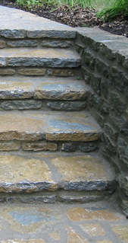
Shield Steps
Create your Green Team
Build a plan
Hold a weekend event
Have a worship service
Classes for kids, teens, and adults
Participants take the Energy or Water Pledge
Publicize your good work
Apply for the Shield
Notes:
In order to get the Shield there are a few qualifications or steps that you need to do
You need to create you team – just a few people maybe 2- 4 people
Build and execute an action plan – There are 13 best Energy or 7 best Water practices laid out for you. Some you need to do and others are optional
Hold an energy/ water weekend or weekends. This includes
- a worship service
- Educational classes and activities for people of different ages
Young Children, teens , and adults
- Have the individual households take the Energy/Water Pledge
Your good work should be publicized in the community
And you need to fill out the Shield Application.

Slide 10
#1. Create Your Team
Choose a small dedicated group
Determine the plan
Organize weekend activities
Communicate with GreenFaith
Follow up
Notes:
You only need a small group of people to accomplish this.
Choose the people from either your Men’s Club or from different groups across the temple
No Professionals needed
Keep in mind what they will be doing and be sure you have all the skills covered.
Be part of the movement – FJMC, USCJ, WLCJ, RA

Slide 11

#2. The Action Plan
Can be inexpensive
Quick and Easy to implement
Define your Energy/Water baseline
Audit your facility
Choose from 13 best energy practices or from 7 water ones to initiate
Notes:
The action plan.
This should be fast acting and easy to implement. While meant to be inexpensive, there are lots of things that can be done.
For the Energy Action Plan
You will create your energy baseline so that you have something to measure the changes against. You will enter 2 years worth of energy bill data into Energy Star’s Portfolio Manager .
You will Audit your facility for Energy Waste. If you want, there may be professional energy audits available for free or at a greatly reduced cost.
There are 13 identified best practices. You will initiate 4 standard ones and choose 4 additional ones.
Water
Calculate your water footprint. www.gracelinks.org/3404/water-footprint-calclator, This evaluates usage and costs
Go to WaterSense. This certification ensures your appliances are the most water efficient in their class. www.epa.gov/watersense/
Check for leaks, Indoor and outside. Each month check all appliances, rest-rooms for leaks.

Slide 12
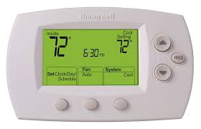


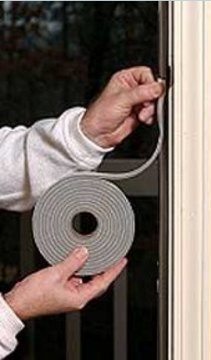
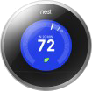


Your Energy Action Plan May Include:
Notes:
You can look at replacing some of the lights in areas that are on more than 15 hours per day
Install programmable thermostats and program them meaningfully
Check windows and doors for drafts and install weather-stripping
Look to replace Appliances

Slide 13


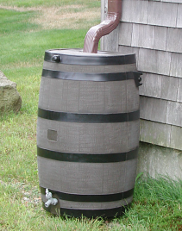

Your Water Action Plan Includes:
5 Easy Steps, 4 Indoors and 1 Outdoors
2 Challenging Steps, 1 Indoors and 1 Outdoors
Notes:
Easy steps:
Don’t Waste water signs, Restrooms, Kitchen, water fountain
Don’t Waste water project/ talk for children
Pet, Child, Environment friendly Ice Melt (home)
Kick the bottled water habit, serve filtered tap water (Cal- Nestle)
Watering shrub and trees use timer and “weeper hoses”
Check all faucets, appliances, toilets for leaks quarterly
Challenging:
Replace old toilets with water efficient ones
Install Rain Barrels or Rain Gardens
Make your landscape water friendly. Use plants native to your area and climate
Calculate your water footprint.

Slide 14

Use Your Planning Resources
FJMC’s Shomrei Ha'Aretz page
http://www.fjmc.org/content/stewards-land
Prayers and sacred texts
Lesson plans for adults, teens, and children
Fact sheets
Bulletin inserts / handouts
Facts and figures
Telephone and email support
Notes:
You are not planning this alone. No need to reinvent the wheel.
Both FJMC and GreenFaith have lots of resources available to you to make it easier.
FJMC has the Shomrei Ha’Aretz page at http://www.fjmc.org/content/stewards-land
And there are torch awards that you can look at as well.
http://greenfaith.org/programs/greenfaith-shield
www.FJMC.org/content/stewards-land
www.CanfeiNesharim.org (Sustainable Living Inspired by Torah) Water is a major topic in Torah

Slide 15
#3. Hold Your Weekend Event
Worship Service
Educational Classes
Different classes for different ages
Take the pledge
“I pledge to make my life a blessing for the earth”
Notes:
During your weekend event you need to hold a Worship Service. Educational Classes and you need to have a certain percentage of your congregation the the pledge.
During our Energy weekend Our Rabbi had arranged for Rabbi Larry Troster to be our scholar in residence.
we had Rabbi Troster address
Our preschool kids and parents Friday morning
The adults on Friday night
Saturday sermon
Saturday afternoon study , following Kiddush lunch
Sunday he did a lecture during one of the sessions.
We also had
Palm Beach County Solid Waste Authority for a talk on recycling
Florida Power and Light discussing Home Energy Savings.
Some of the lectures were
- Friday, 11:00 am, "Bringing the Wonder of Creation to Our Children"
- Friday, 7:30 pm, "Jewish Environmental Spirituality and Practice"
- Saturday, 9:00 am, "The Temple and the Green Synagogue: How to Make Our Buildings Reflect Our Values"
- Saturday, 12:30 pm, "All in the Same Boat; A Text Study on Jewish Environmental Justice"
- Sunday, 11:15 am, "The Pursuit of Happiness: Ancient Jewish Wisdom for Sustainable Living“
WATER Weekend can use a similar arrangement. I have some copies of resource material available

Slide 16

Get the Congregation Involved
Temple Beth Tzedek created an Energy Hero to better reach the kids
3 different age-based programs
Temple Torat Emet (my Temple) held an energy weekend with our social action committee
Energy sermons and activities Friday through Sunday
Our Rabbi, Rabbi Edward Bernstein, is a GreenFaith Fellow
Notes:
Temple Beth Tzedek from Buffalo NY got the kids involved. With simple activities like
Turning off the TV when you leave the room
Putting on a sweater instead of adjusting the thermostat
Simple activities make a difference. Temple Beth Tzedek had
The kids draw a picture of themselves as an energy hero.
They had them think about how G-d would want them to repair the world.
The Older kids learned about renewable energy
Our Event at Temple Torat Emet was really initiated by our Rabbi. As a Greenfaith fellow it was his passion for this certification, and that was the catalyst for the Temple’s energy weekend.

Slide 17
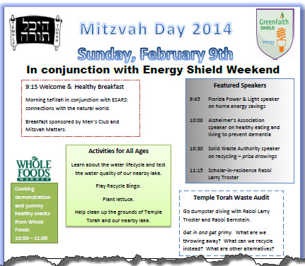
Our Energy Weekend was Busy!
Speakers on the different types of energy
Age appropriate activities
Temple-wide function
Notes:
Our Energy weekend was a very busy one. Since we held it in conjunction with our Social Action committee we covered more than just the energy shield requirements. It took place on our annual Mitzvah Day
We focused on energy in general
Personal and Environmental
Wanted to attract people of all different ages
The goal for Men’s Club and the Rabbi was to take steps to “Greenify” our Synagogue
We Worked at obtaining the GreenFaith Energy Shield and Instituting Recycling programs
First a Healthy Breakfast
Religion classes
Environmental cleanup
Energy savings for the home
Cooking demonstrations
Water testing
Educational talks
Donations for causes
Health discussions
Healthy snacking / eating
Planting Greens
Garbage
Getting Dirty - A Dumpster Crawl

Slide 18
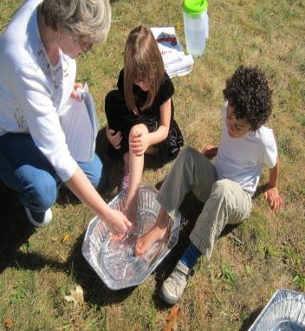
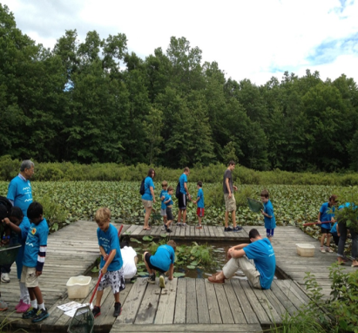
Water Activities
Notes:
Pictures Form Green Faith file of water activities
When playing outside use a container instead of a hose to wash
Picking up trash from a wet land and river

Slide 19
#4. Publicize Your Good Work
Don’t keep it a secret!
Announce plan
Give updates
Issue preliminary bulletin
Report progress
Notes:
Don’t keep it a secret!
1. Temple Bulletin & e-mail: Announce the program plan, give updates, issue a Broadside before program starts, and Report the results. 2. Local; News papers, websites, Jewish Federation News, Religious Organizations: Report the results 3. Use electronic media, Post videos on YouTube 4. FJMC Regional and National publications : Report the results
Temple Torat Emet posted many things
Article in Sun Sentinel
http://articles.sun-sentinel.com/2014-02-03/florida-jewish-journal/fl-jjpn-green-0205-20140203
YouTube Videos
https://www.youtube.com/watch?v=ZTOmScEFC4o&list=UU4wiht0uuar1-DRXbKtPYPQ
https://www.youtube.com/watch?v=tWq6XLz9LSI&list=UU4wiht0uuar1-DRXbKtPYPQ
https://www.youtube.com/watch?v=6WncEngTTCo&list=UU4wiht0uuar1-DRXbKtPYPQ

Slide 20
#5. Report Your Results
Temple Bulletin & e-mail
Local
Newspapers, websites, Jewish Federation News, etc.
Electronic Media
Videos on YouTube
Religious Organizations
FJMC Regional and National publications

Slide 21
#4. Publicize Your Good Work
Don’t keep it a secret!
Article in Sun Sentinel
Temple Goes ‘Green’: http://articles.sun-sentinel.com/2014-02-03/florida-jewish-journal/fl-jjpn-green-0205-20140203
YouTube Videos
Temple Torah Goes Green: Mitzvah Day 2014. https://www.youtube.com/watch?v=ZTOmScEFC4o&list=UU4wiht0uuar1-DRXbKtPYPQ
Rabbi Lawrence Troster meets with JACATT 4th and 5th graders to discuss Judaism and the environment. https://www.youtube.com/watch?v=tWq6XLz9LSI&list=UU4wiht0uuar1-DRXbKtPYPQ
Rabbi Lawrence Troster greets JACATT students at Temple Torah during Kabbalat Shabbat. https://www.youtube.com/watch?v=6WncEngTTCo&list=UU4wiht0uuar1-DRXbKtPYPQ

Slide 22

#5. Apply for Your Shield
http://greenfaith.org
Cost: $50
Notes:
Go to the site and apply
It only costs 50 dollars
The only thing left to do it to ……

Slide 23

Notes:
Make it so

Slide 24
END OF PRESENTATION

